Slide 1


Young Children’s Disambiguation of Words and Symbolic Gestures: Implications for Domain-Specificity
Sumarga (Umay) Suanda & Laura L. Namy

Slide 2
Symbolic Gestures
Acredolo & Goodwyn (1985): Symbolic gesturing in language development. Human Development
Acredolo & Goodwyn (1988): Symbolic gesturing in normal infants. Child Development

Slide 3
Symbolic Gestures
“non-verbal gestures (often referred to here as ‘signs’) to symbolically represent objects…in order to communicate with those around them)”
(Acredolo & Goodwyn, 1988, pp. 450)
Examples:
Sniffing gesture – [flower]
Arms extended out – [airplane]

Slide 4
Similarities between words and symbolic gestures
Observational / Parent Diary (12 to 18 months):
Similar age of onset
Serve similar communicative functions
Tend to be mutually exclusive in lexicons
(Acredolo & Goodwyn, 1985, 1988; Caselli, 1994;
Iverson et al., 1994; Shore et al., 1994)

Slide 5
Similarities between words and symbolic gestures
Experimental research (14 -18 mo):
Show similar mapping and extension patterns
Both guide similar inference patterns about object properties
Semantic processing shows similar patterns of neural activation
(Graham et al., 2007; Namy, 2001;
Namy et al., 2004; Namy & Waxman, 1998;
Sheehan et al., 2007)

Slide 6
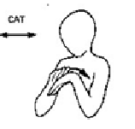

A unified early lexicon?
One view of words and gestures in early development:
“…gestures and words form a single lexicon” (Clark, 2003)
“…there is one lexicon constructed partially from gestures and partially from words” (Caselli, 1994)
“car”
“hat”
“dog”
“shoe”

Slide 7
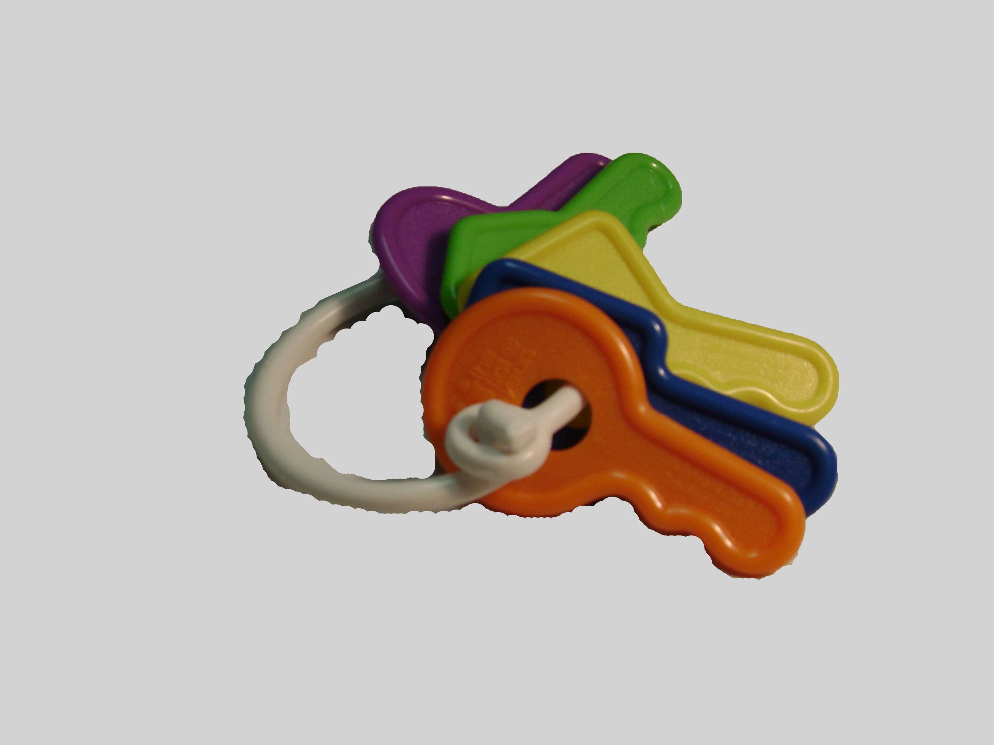
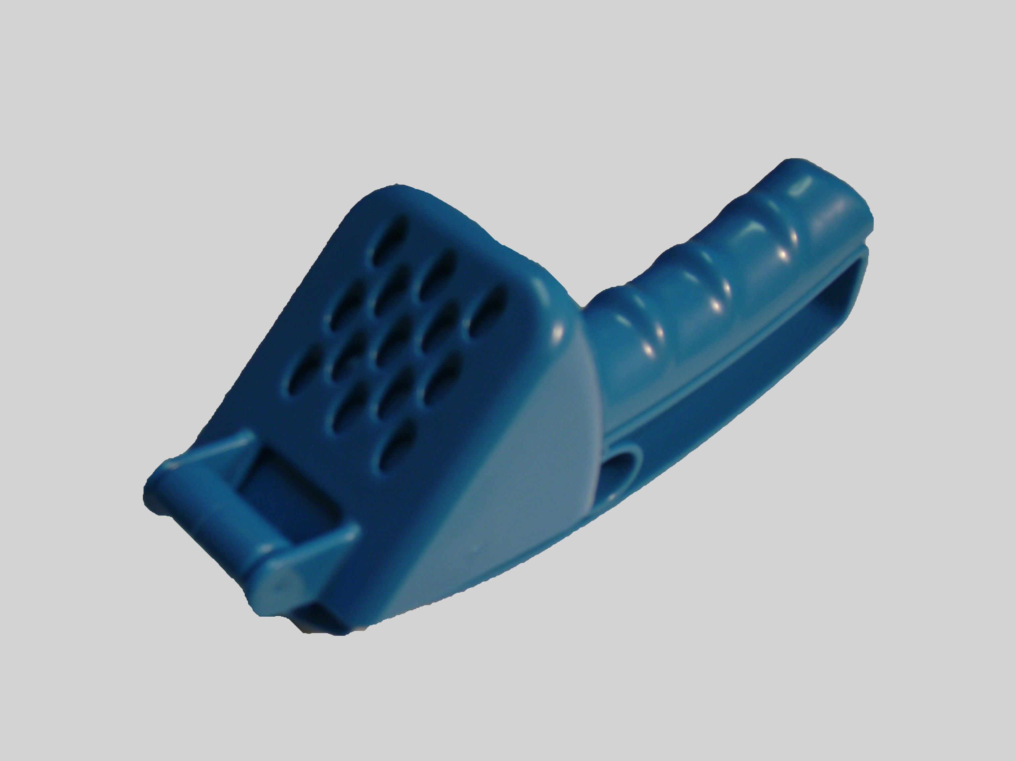
Experiment 1 Goal: Is lexicon unified?
Verbal disambiguation task:
Children avoid lexical overlap
familiar object
(in lexicon)
novel object
(not in lexicon)
Where’s the blicket?
e.g., Markman &
Wachtel (1988)

Slide 8
Experiment 1 Goal: Is lexicon unified?
Gestural disambiguation task:
Will children also avoid word-gesture overlap?
familiar object
(in lexicon)
novel object
(not in lexicon)
“car”
“hat”
“keys”
“shoe”
Where is it?

Slide 9
Experiment 1: Methods
Participants: 32 18-month-olds (M_{age}=18.4)
Design: Between subjects (word vs. gesture conditions)

Slide 10
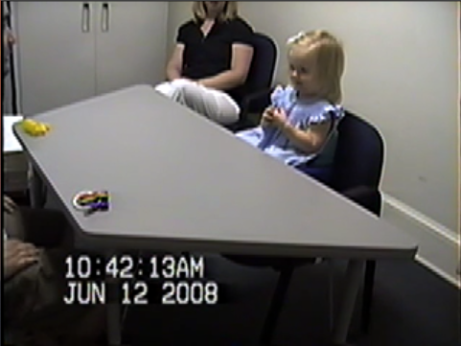
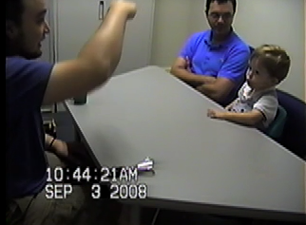
Experiment 1: Methods
Disambiguation task: Target Trial +
Control Trial
Word Condition: Target Trial
Gesture Condition: Target Trial
Can you get it? blicket
Can you get it? [gesture]

Slide 11
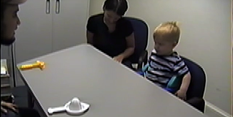
Experiment 1: Methods
Disambiguation task: Target Trial +
Control Trial
Both Conditions: Control Trial
Can you get one?

Slide 12
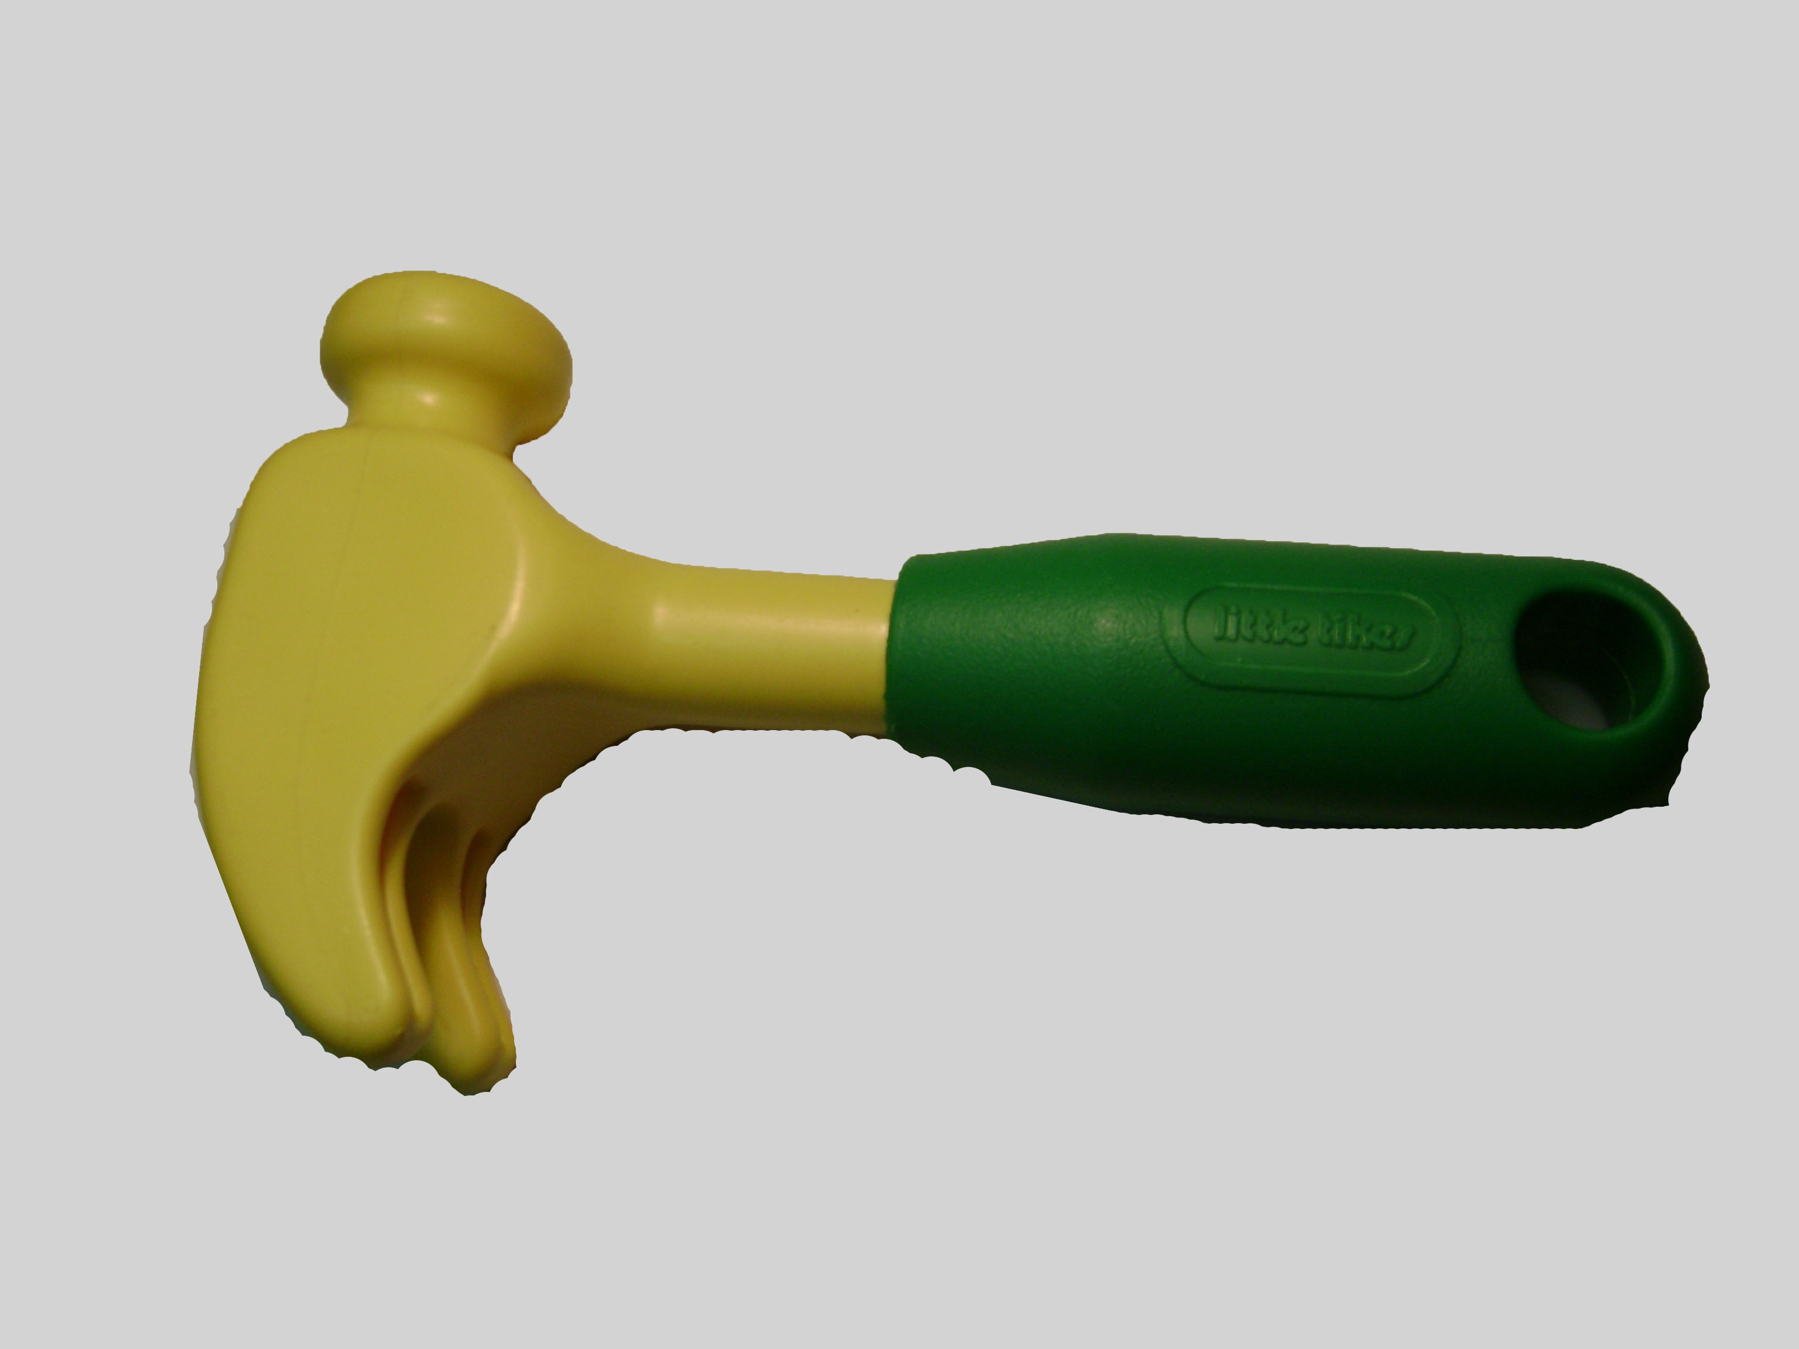
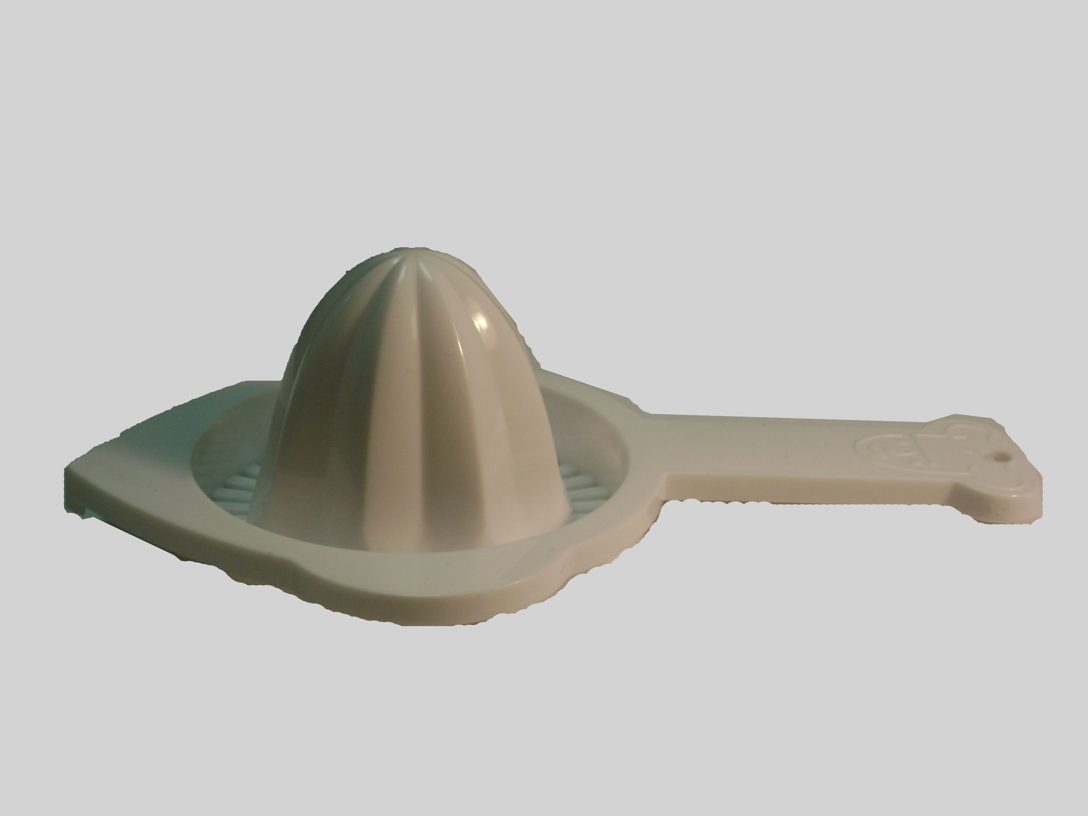
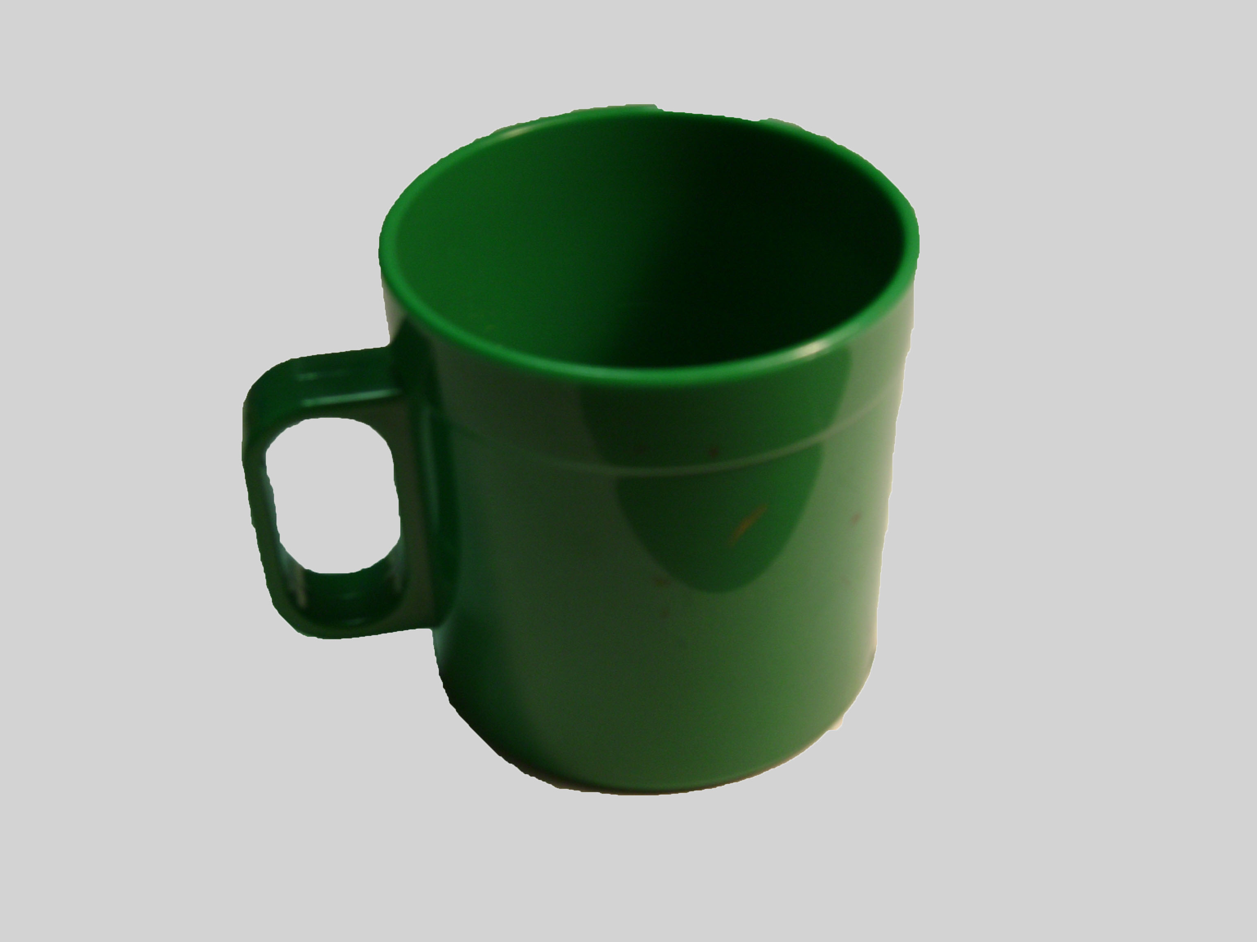
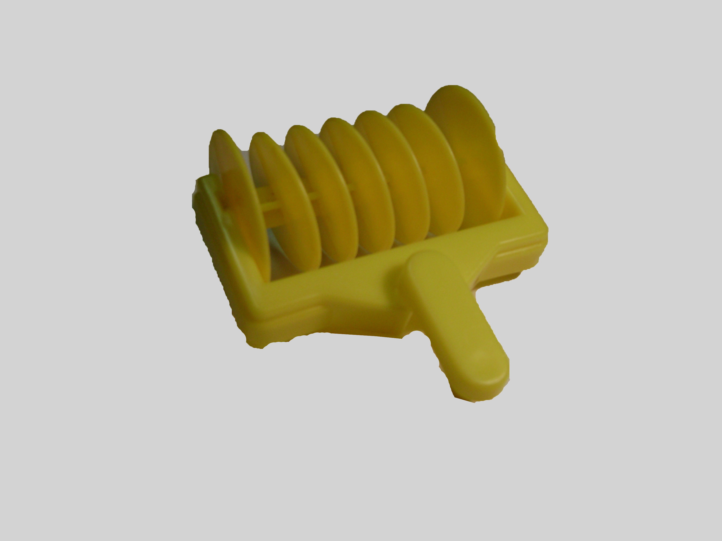
Experiment 1: Methods
Disambiguation task:
3 object sets
2 target and 2 control trials in each set
Familiar Objects | Novel Objects

Slide 13
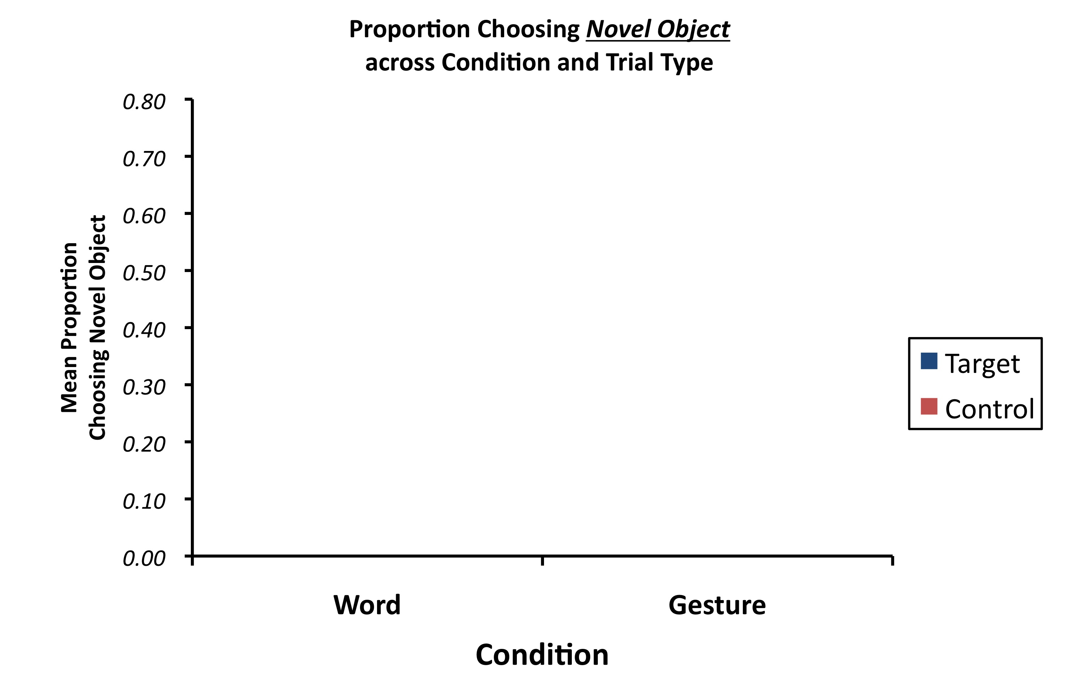
Experiment 1: Results
Garlic press
Keys

Slide 14
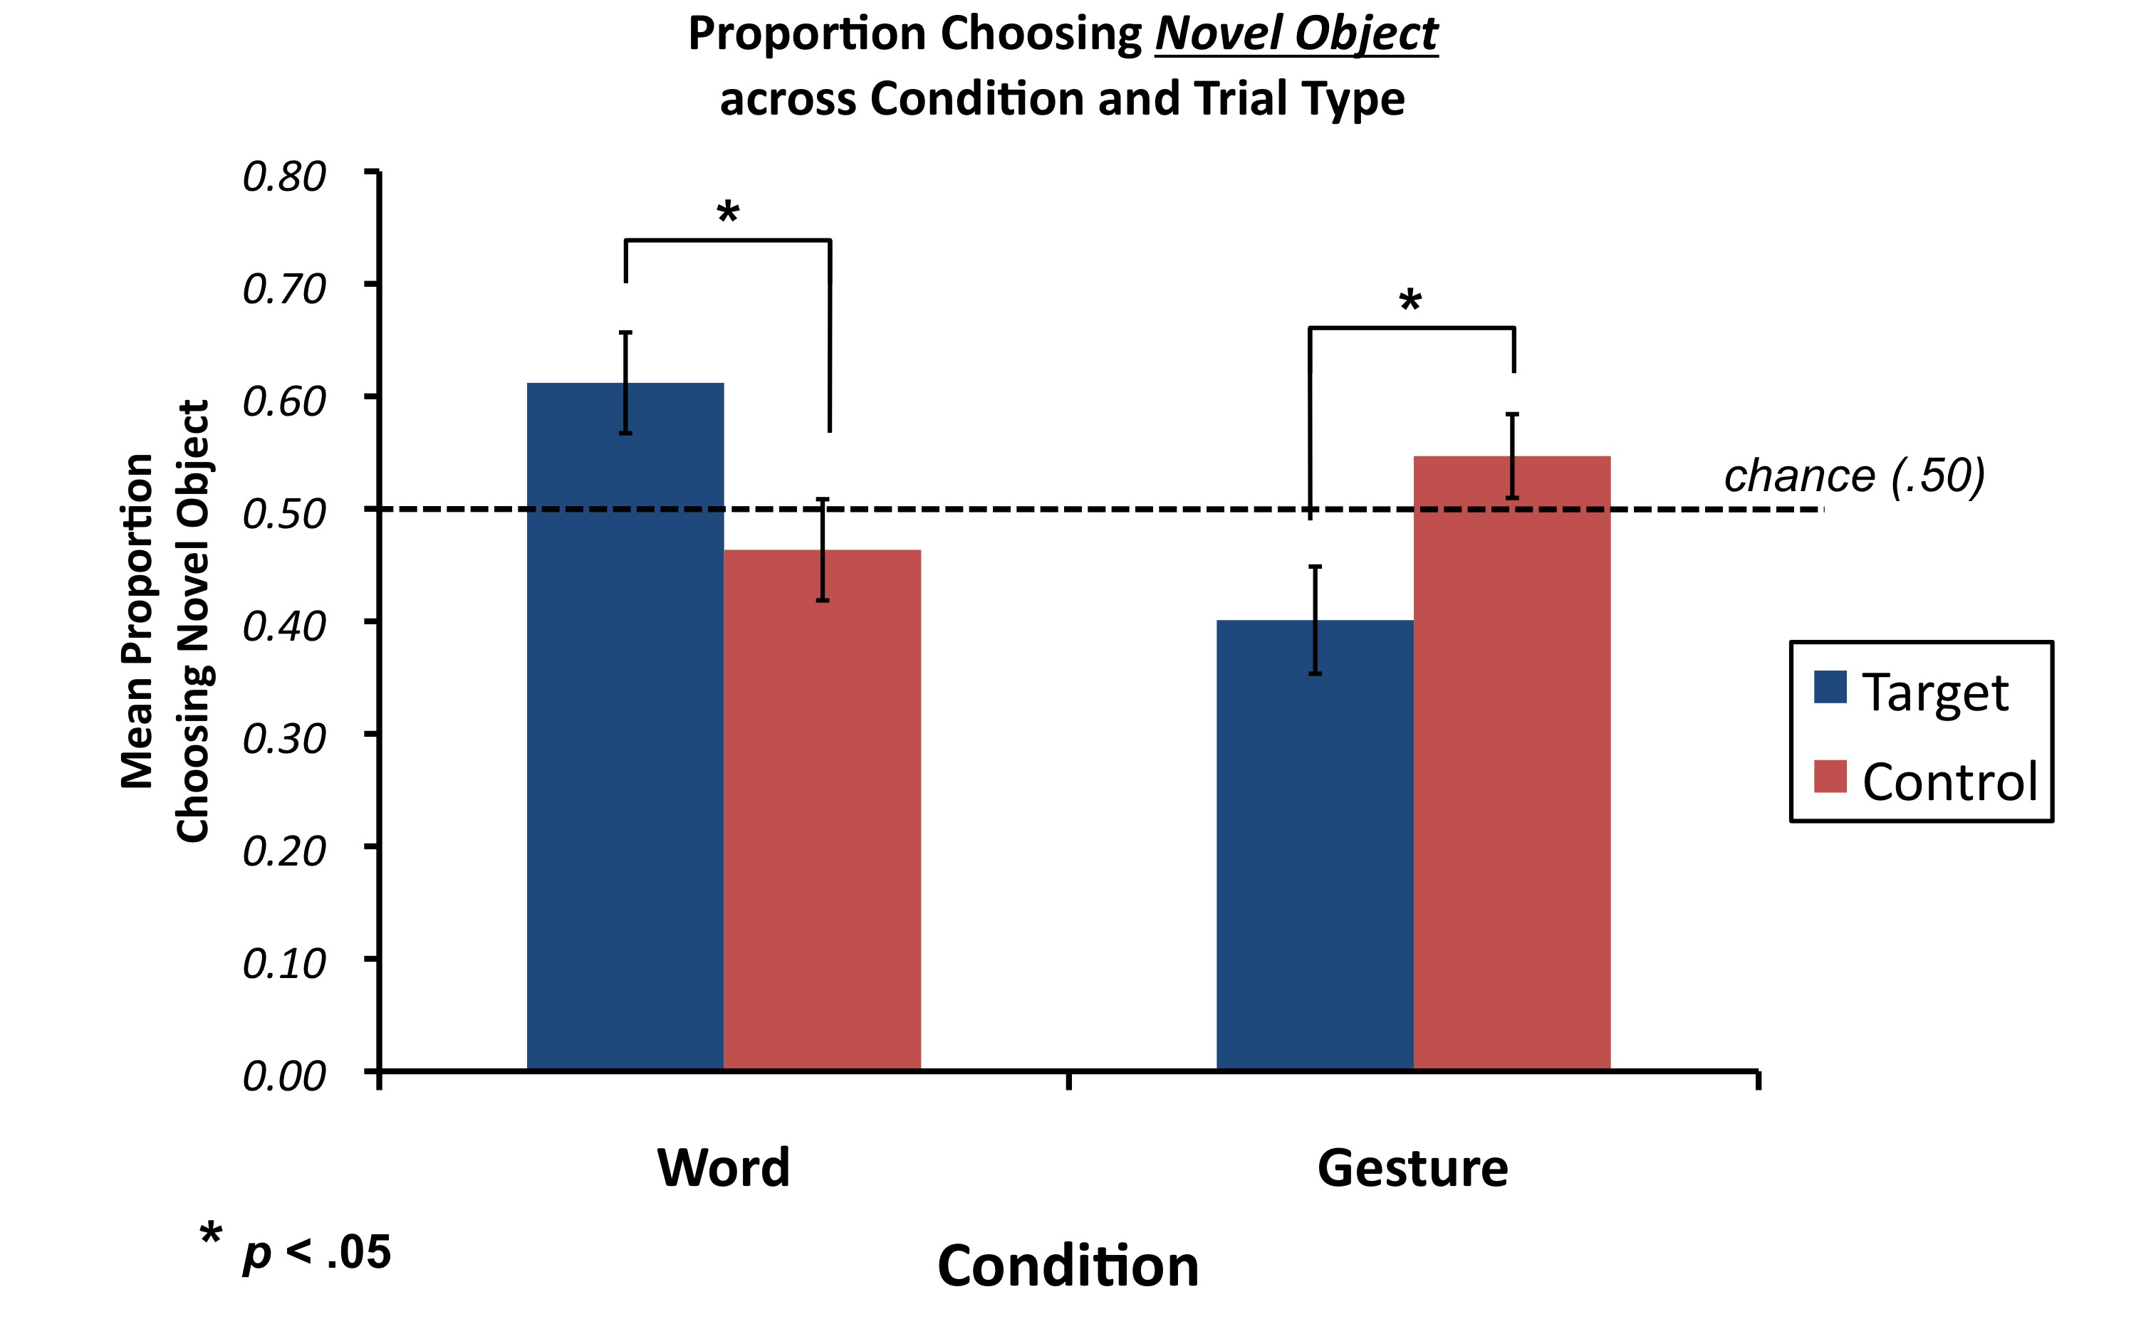
Experiment 1: Results
Suanda & Namy (2013) Infancy

Slide 15
Research Goals
Test single lexicon idea (Exp 1):
In a gesture disambiguation task, will children select the novel object?
Different Lexicon
Unified Lexicon
“dog”
“dog”
“hat”
“hat”
“car”
“shoe”
“car”
“shoe”

Slide 16
Why would children not select the novel object in the gesture task?
Different Lexicon
Disambiguation does not generalize between words and gestures
Disambiguation does generalizes but children don’t have a gesture for familiar object
“dog”
“hat”
“car”
“shoe”

Slide 17
Research Goals
Test single lexicon idea (Exp 1)
Test whether disambiguation generalizes to gesture domain (Exp 2):
Create a condition where children have a gestural label for an object
Will children avoid linking a second gesture to that object (i.e., gesture-gesture overlap)?

Slide 18
Experiment 2: Methods
Participants: 32 18-month-olds (M_{age} = 18.3)
Design: Between subjects (word vs. gesture conditions)
Task:
Learning Phase + Disambiguation Task

Slide 19
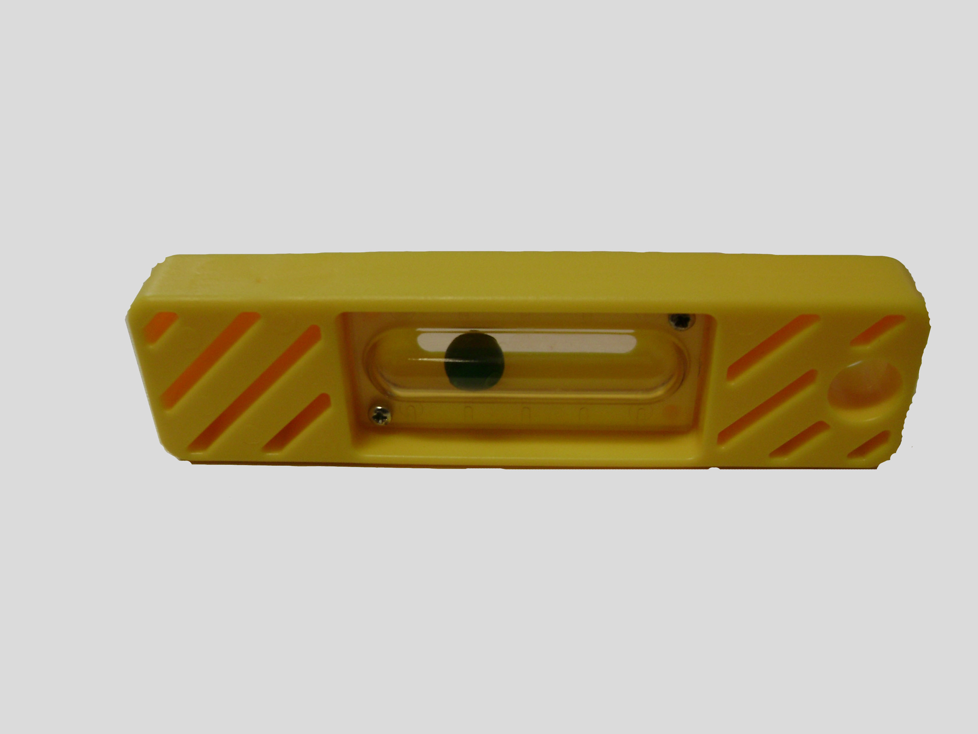
Experiment 2: Methods
Learning Phase
Disambiguation
Phase
One object is labeled with word or gesture
Other object is
not labeled
Object request with a new label
Look, at this
one!
Which one can you get? Blicket!
Look, riffle!

Slide 20
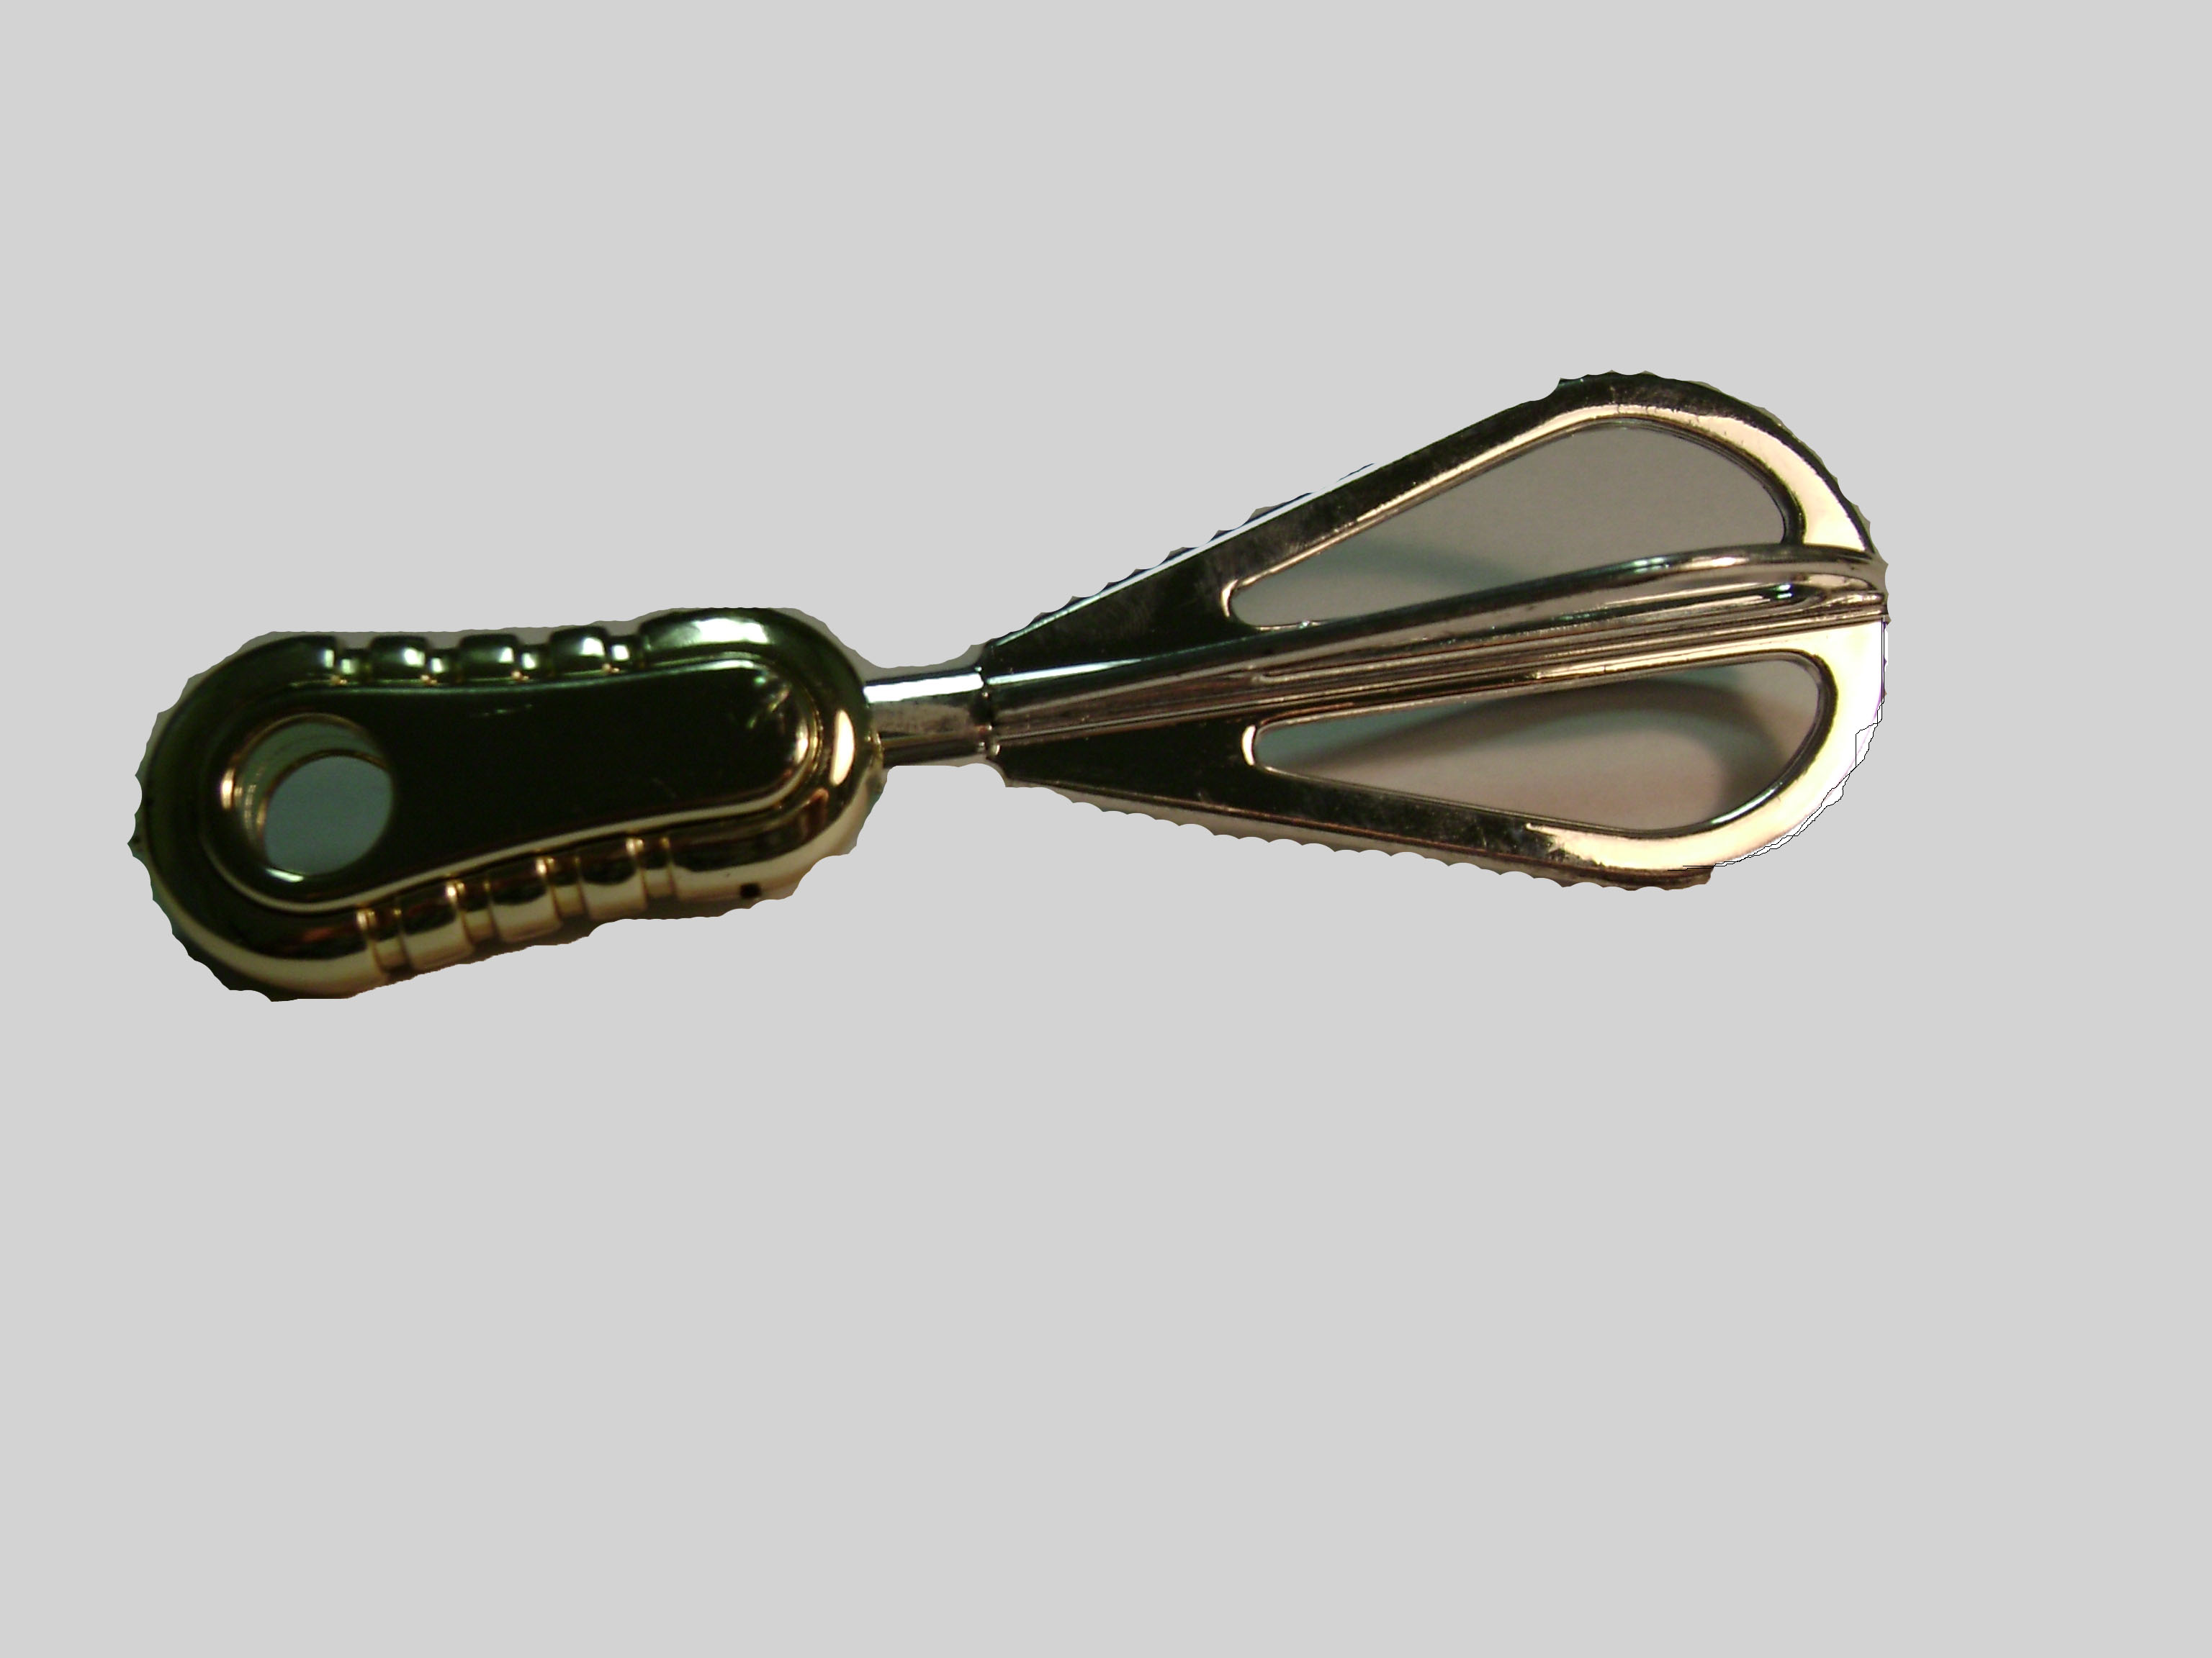
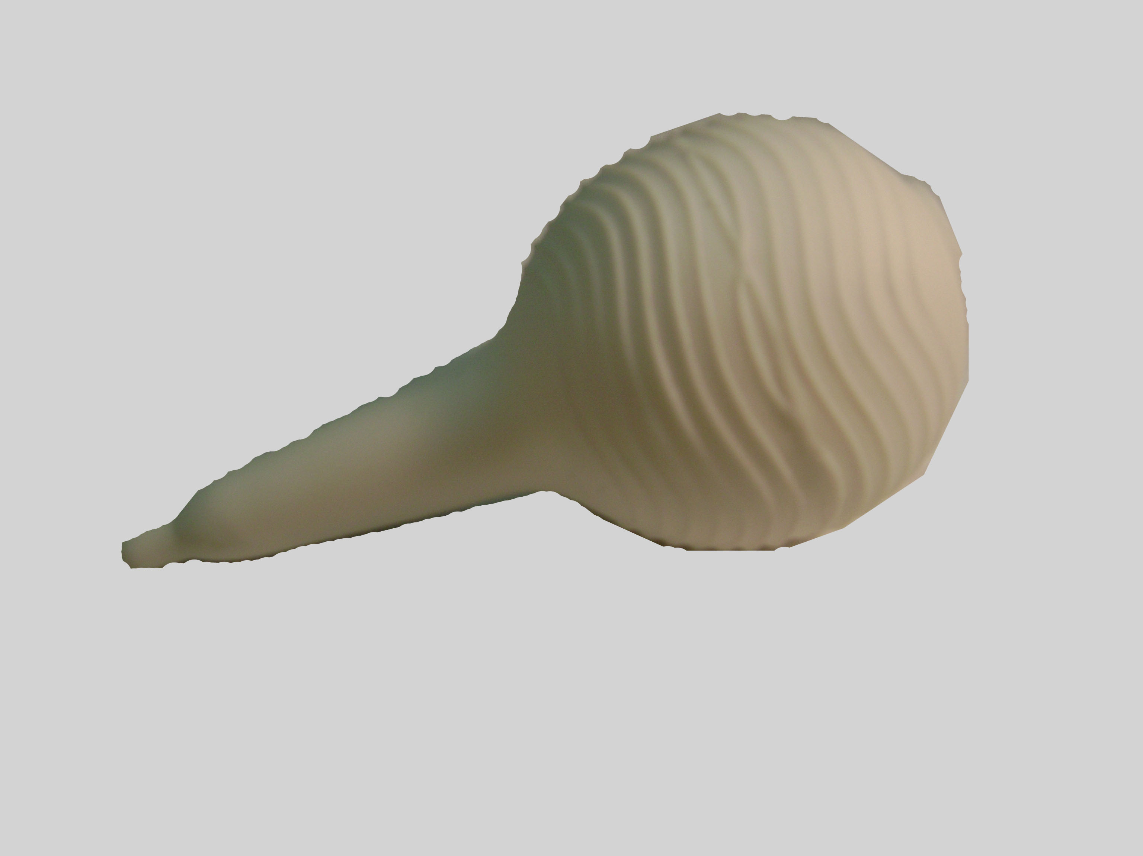
Experiment 2: Methods
Disambiguation task:
3 object sets
2 target and 2 control trials in each set
Novel Objects

Slide 21
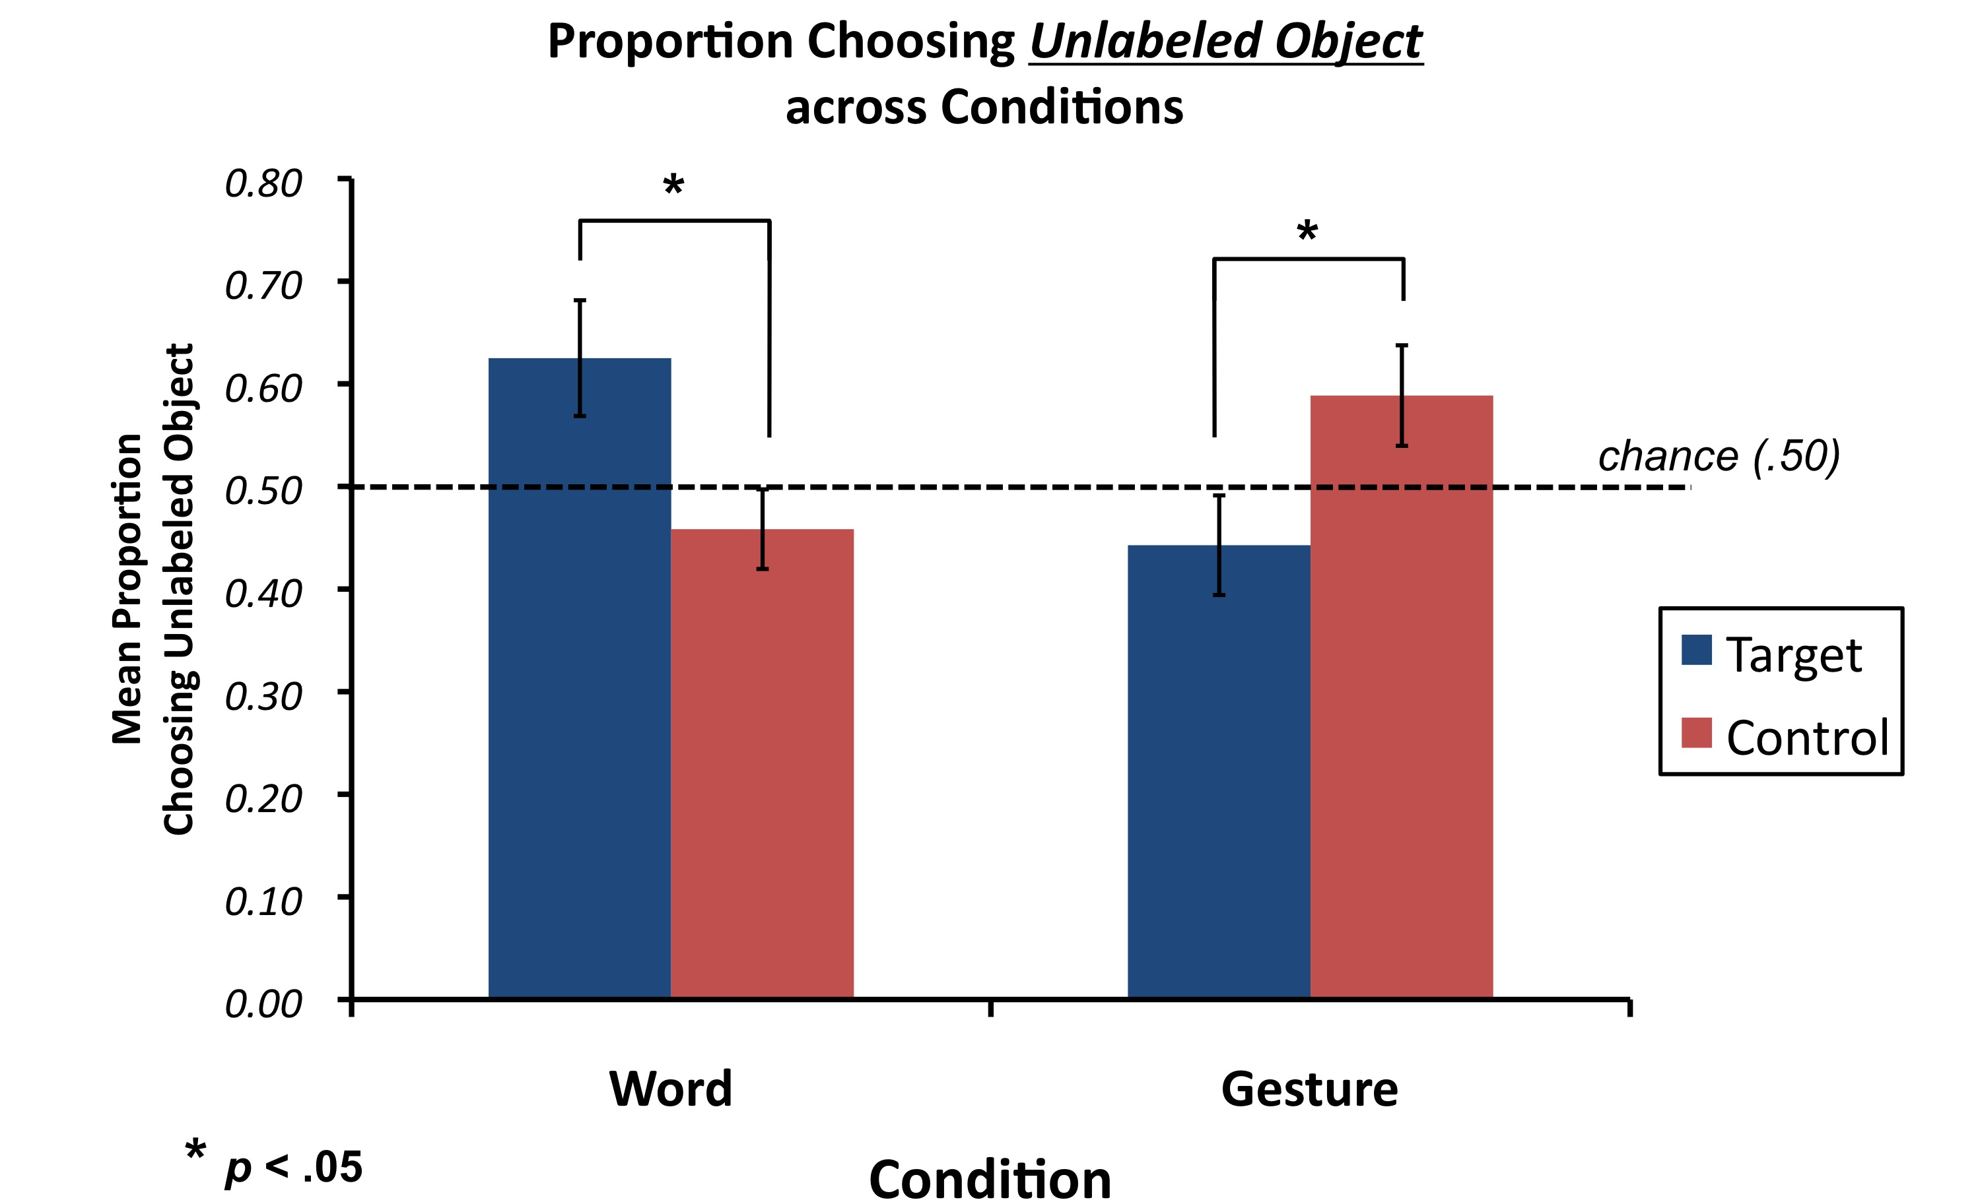
Results
Suanda & Namy (2013) Child Dev.

Slide 22
Research Goals
Test single lexicon idea (Exp 1)
Test whether disambiguation generalizes to gesture domain (Exp 2):
Will children avoid gesture-gesture overlap?
No

Slide 23
Result Summary
Avoid word-word overlap? | YES | (Exp 1, 2)
Avoid word-gesture overlap? | NO | (Exp 1)
Avoid gesture-gesture overlap? | NO | (Exp 2)

Slide 24
Implications for words & gestures
Findings are inconsistent with the notion of a single lexicon comprised of words and gestures
It is possible that a single lexicon idea characterizes earlier development
Consistent with observation work showing mutually exclusive use of words and gestures at 12 to 16 months (Acredolo & Goodwyn, 1988; Iverson et al., 1994)

Slide 25
Implications for words & gestures
Findings are inconsistent with full “equipotentiality with which children acquire and interpret verbal and gestural symbols early in development” (Namy et al., 2000, pp. 67)

Slide 26
Implications for words & gestures
Findings are inconsistent with full equipotentiality between words and gestures
Symbol Mapping
Symbolic Gestures
Word
Sensitivity to sentential context
Namy & Waxman (1998) Namy (2001) Namy et al. (2004) Graham & Kilbreath (2007) Sheehan et al. (2007) Suanda et al. (2013) Namy & Waxman (2000) Suanda & Namy (2013)
Semantic Processing
disambiguation
Symbol Generalization
Inductive inference

Slide 27
Implications for disambiguation
Findings are consistent with a domain-specific view of disambiguation
…but also with the view of disambiguation as a domain-general mechanism that emerges as a function of experience

Slide 28
Implications for disambiguation
Support for domain-general + experience view:
Disambiguation is found in multiple non-word domains:
facts
(Diesendruck & Markson, 2001, Scofield & Behrend, 2007)
object functions
(Casler & Kelemen, 2005; Diesendruck et al., 2010)
face-voice mappings
(Halberda)
animal sounds
(Bion et al.)

Slide 29
Implications for disambiguation
Support for domain-general + experience view:
Computational models of word learning suggest that disambiguation could emerge out of domain-general processes (Frank et al., 2009; McMurray, Horst & Samuelson, 2012; Regier, 2003)

Slide 30
Implications for disambiguation
Support for domain-general + experience view:
3. Similar developmental path across domains(?)

Slide 31
Implications for disambiguation
3. Similar developmental path across domains(?)
Symbolic Gestures (Suanda & Namy, 2013) | Novel Gesture – Familiar Object

Slide 32
Implications for disambiguation
3. Similar developmental path across domains(?)
 | Novice Learners | Experienced Learners
Symbolic Gestures (Suanda & Namy, 2013) | Novel Gesture – Familiar Object | ?
Words (Halberda, 2003) | Novel Word – Familiar Object | Novel Word – Novel Object
Facts (Scofield & Behrend, 2007) | Novel Fact – Familiar Object | Novel Fact – Novel Object
Object Functions (Casler & Keleman, 2007) | Novel Object Function – Familiar Object | Novel Function – Novel Object

Slide 33

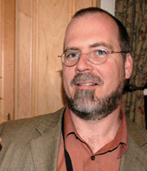

Implications for disambiguation
Support for domain-general + experience view:
4. Comparative work on exclusion learning reveals that monkeys shows a similar dissociation between “referent” selection and retention to that found in children (Bion et al., 2012; Horst & Samuelson, 2008)
Paxton & Hampton
(in progress)

Slide 34
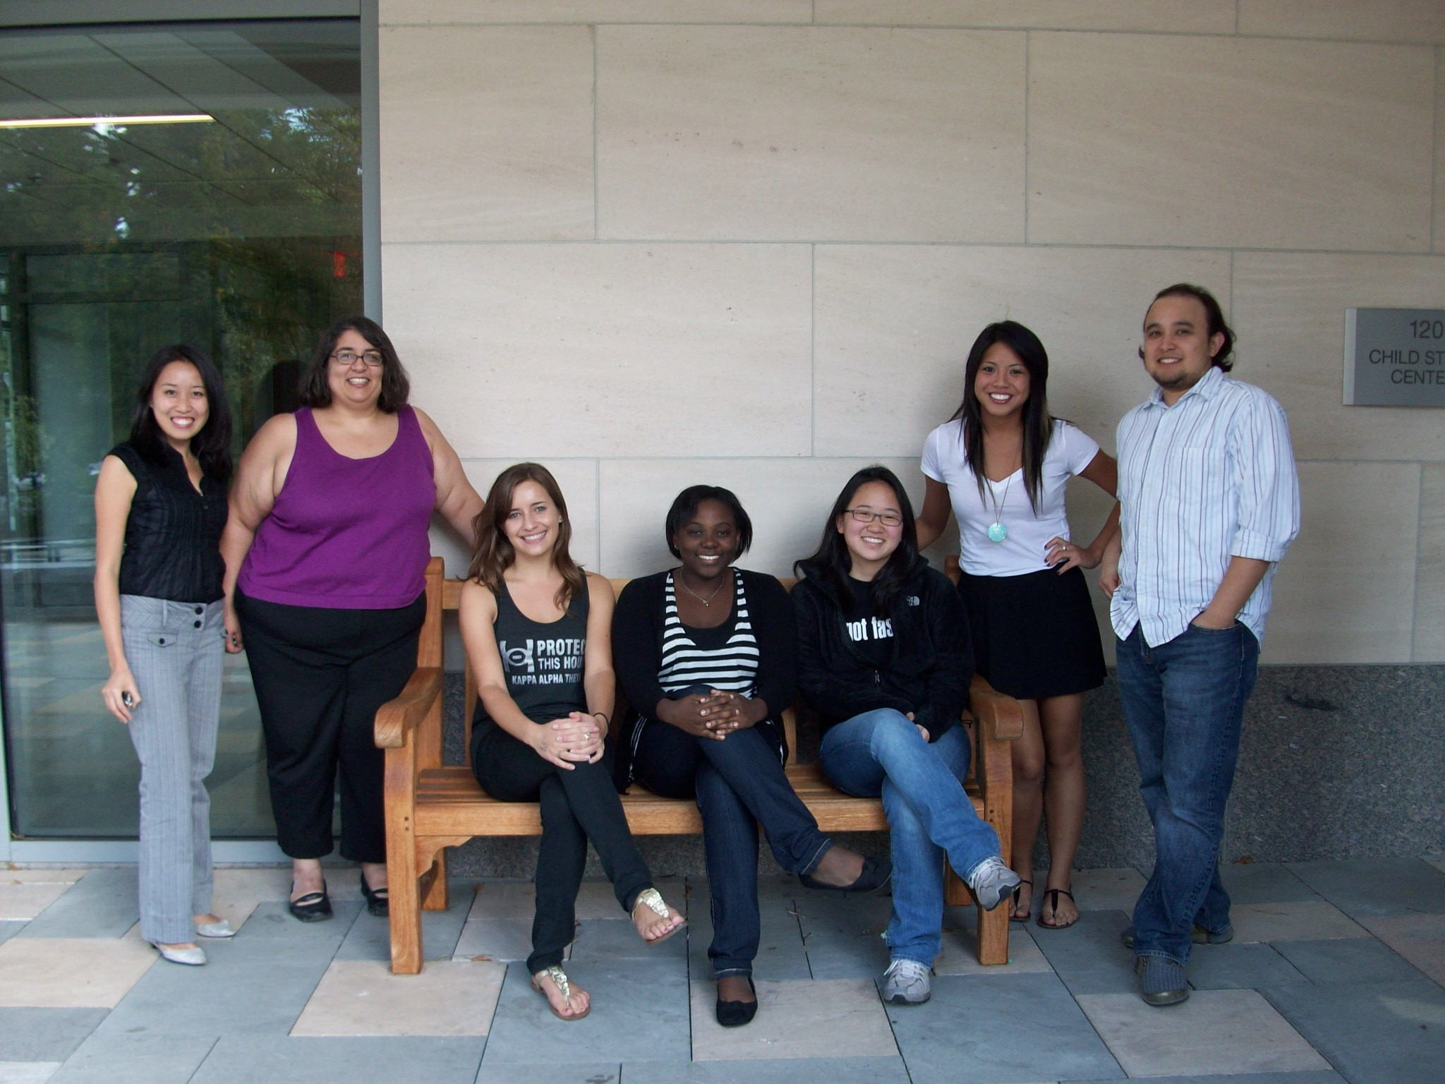


Acknowledgments
Funding Sources:
NSF GRF
NICHD 5-R03-HD058777-02
Namy Language and Learning Lab:
Jane Fisher, Anna Heilbrun, Nassali Mugwanya
Thank you!

Slide 35
Extra Slides

Slide 36
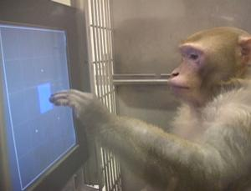

Disambiguation in monkeys
Task 2: disambiguation trials
- Novel symbol
- 3 Familiar + 1 Novel Referents
- Monkeys quickly learned to choose by exclusion
Task 3: results
Learning rates for Set 1 (Association only) and Set 2 (Association + disambiguation) were the same
Performance on disambiguation trials was highly accurate
Monkeys (Macaca mulatta)
Task 1: association trials
symbol-to-referent training
“symbol”
“referent”
Task 3: learn 2 new sets
- Set 1: learn via association trials only
- Set 2: learn via association and disambiguation trials intermixed (twice as many trials)
Paxton & Hampton
(in progress)

Slide 37
Symbol Mapping Study
Learning Phase
Testing
Phase
One object is labeled with word or gesture
Other object is
not labeled
Object request with a new label
Look, at this
one!
Which one can you get? Riffle!
Look, riffle!

Slide 38
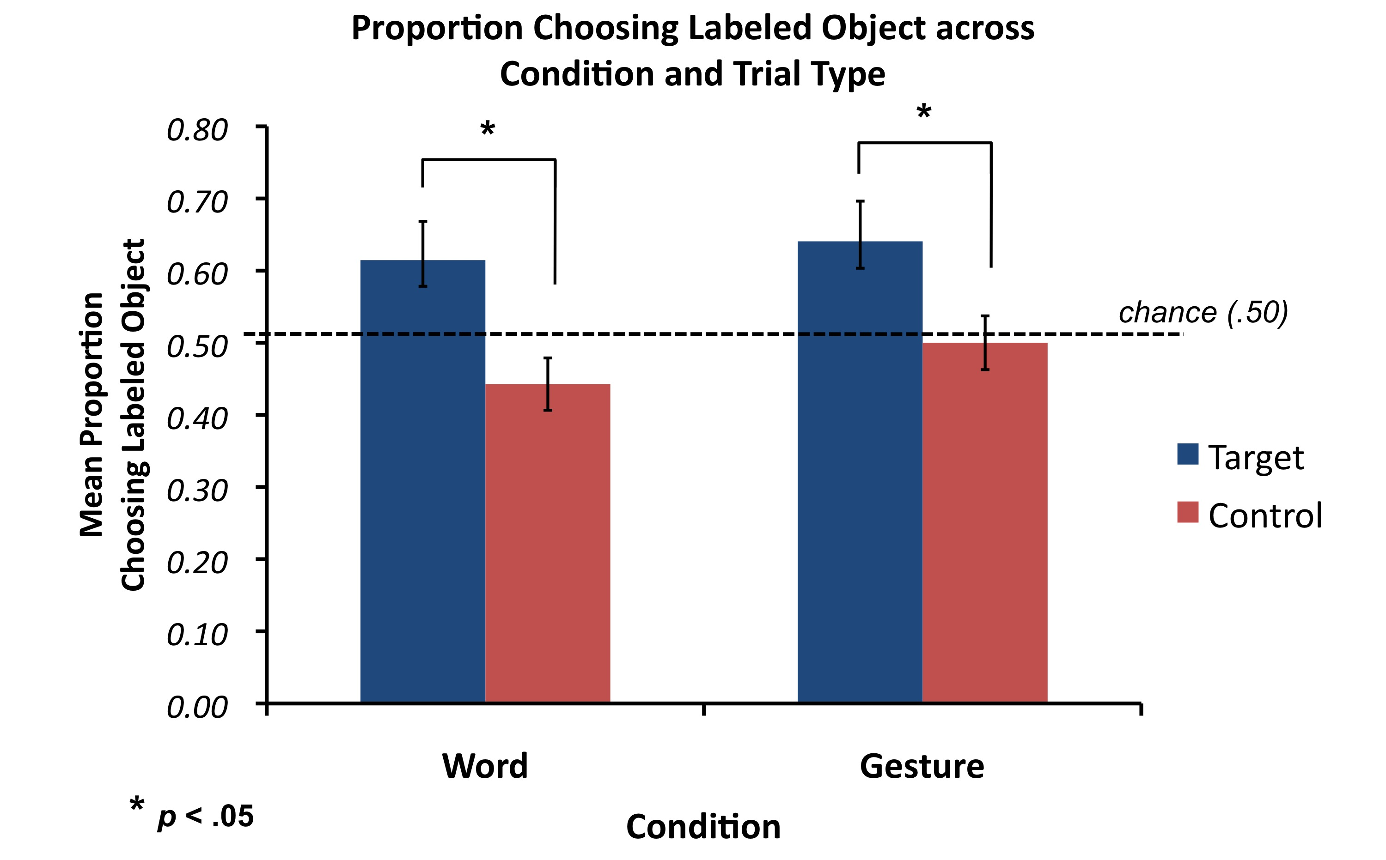
Results: Symbol Mapping

Slide 39
Experiment 1 Results: Individual Patterns
Children were categorized as:
Overlap Avoiders: selected novel object more in target than control trials
Overlap Seekers: selected novel object less in target than control trials
VS.

Slide 40
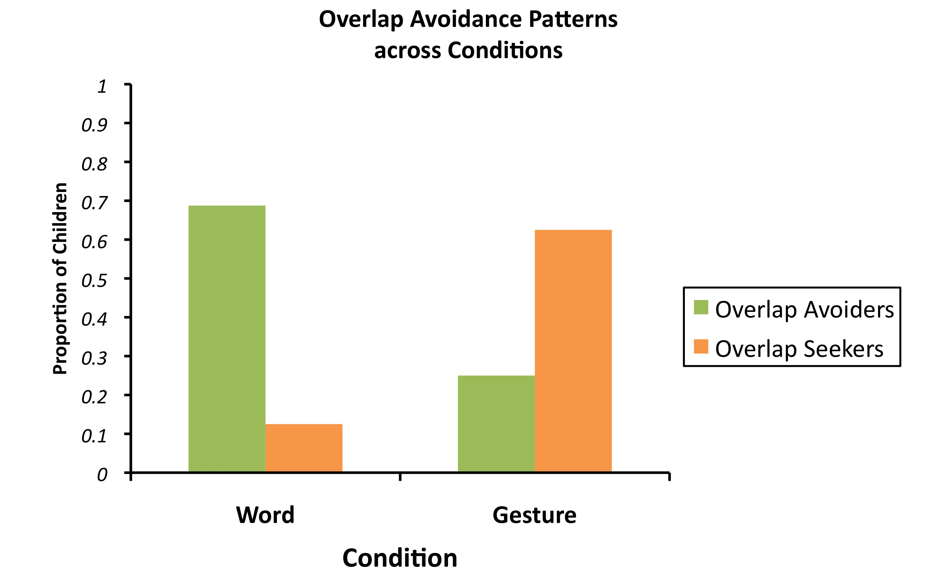
Experiment 1 Results: Individual Patterns
Suanda & Namy (2013) Infancy

Slide 41
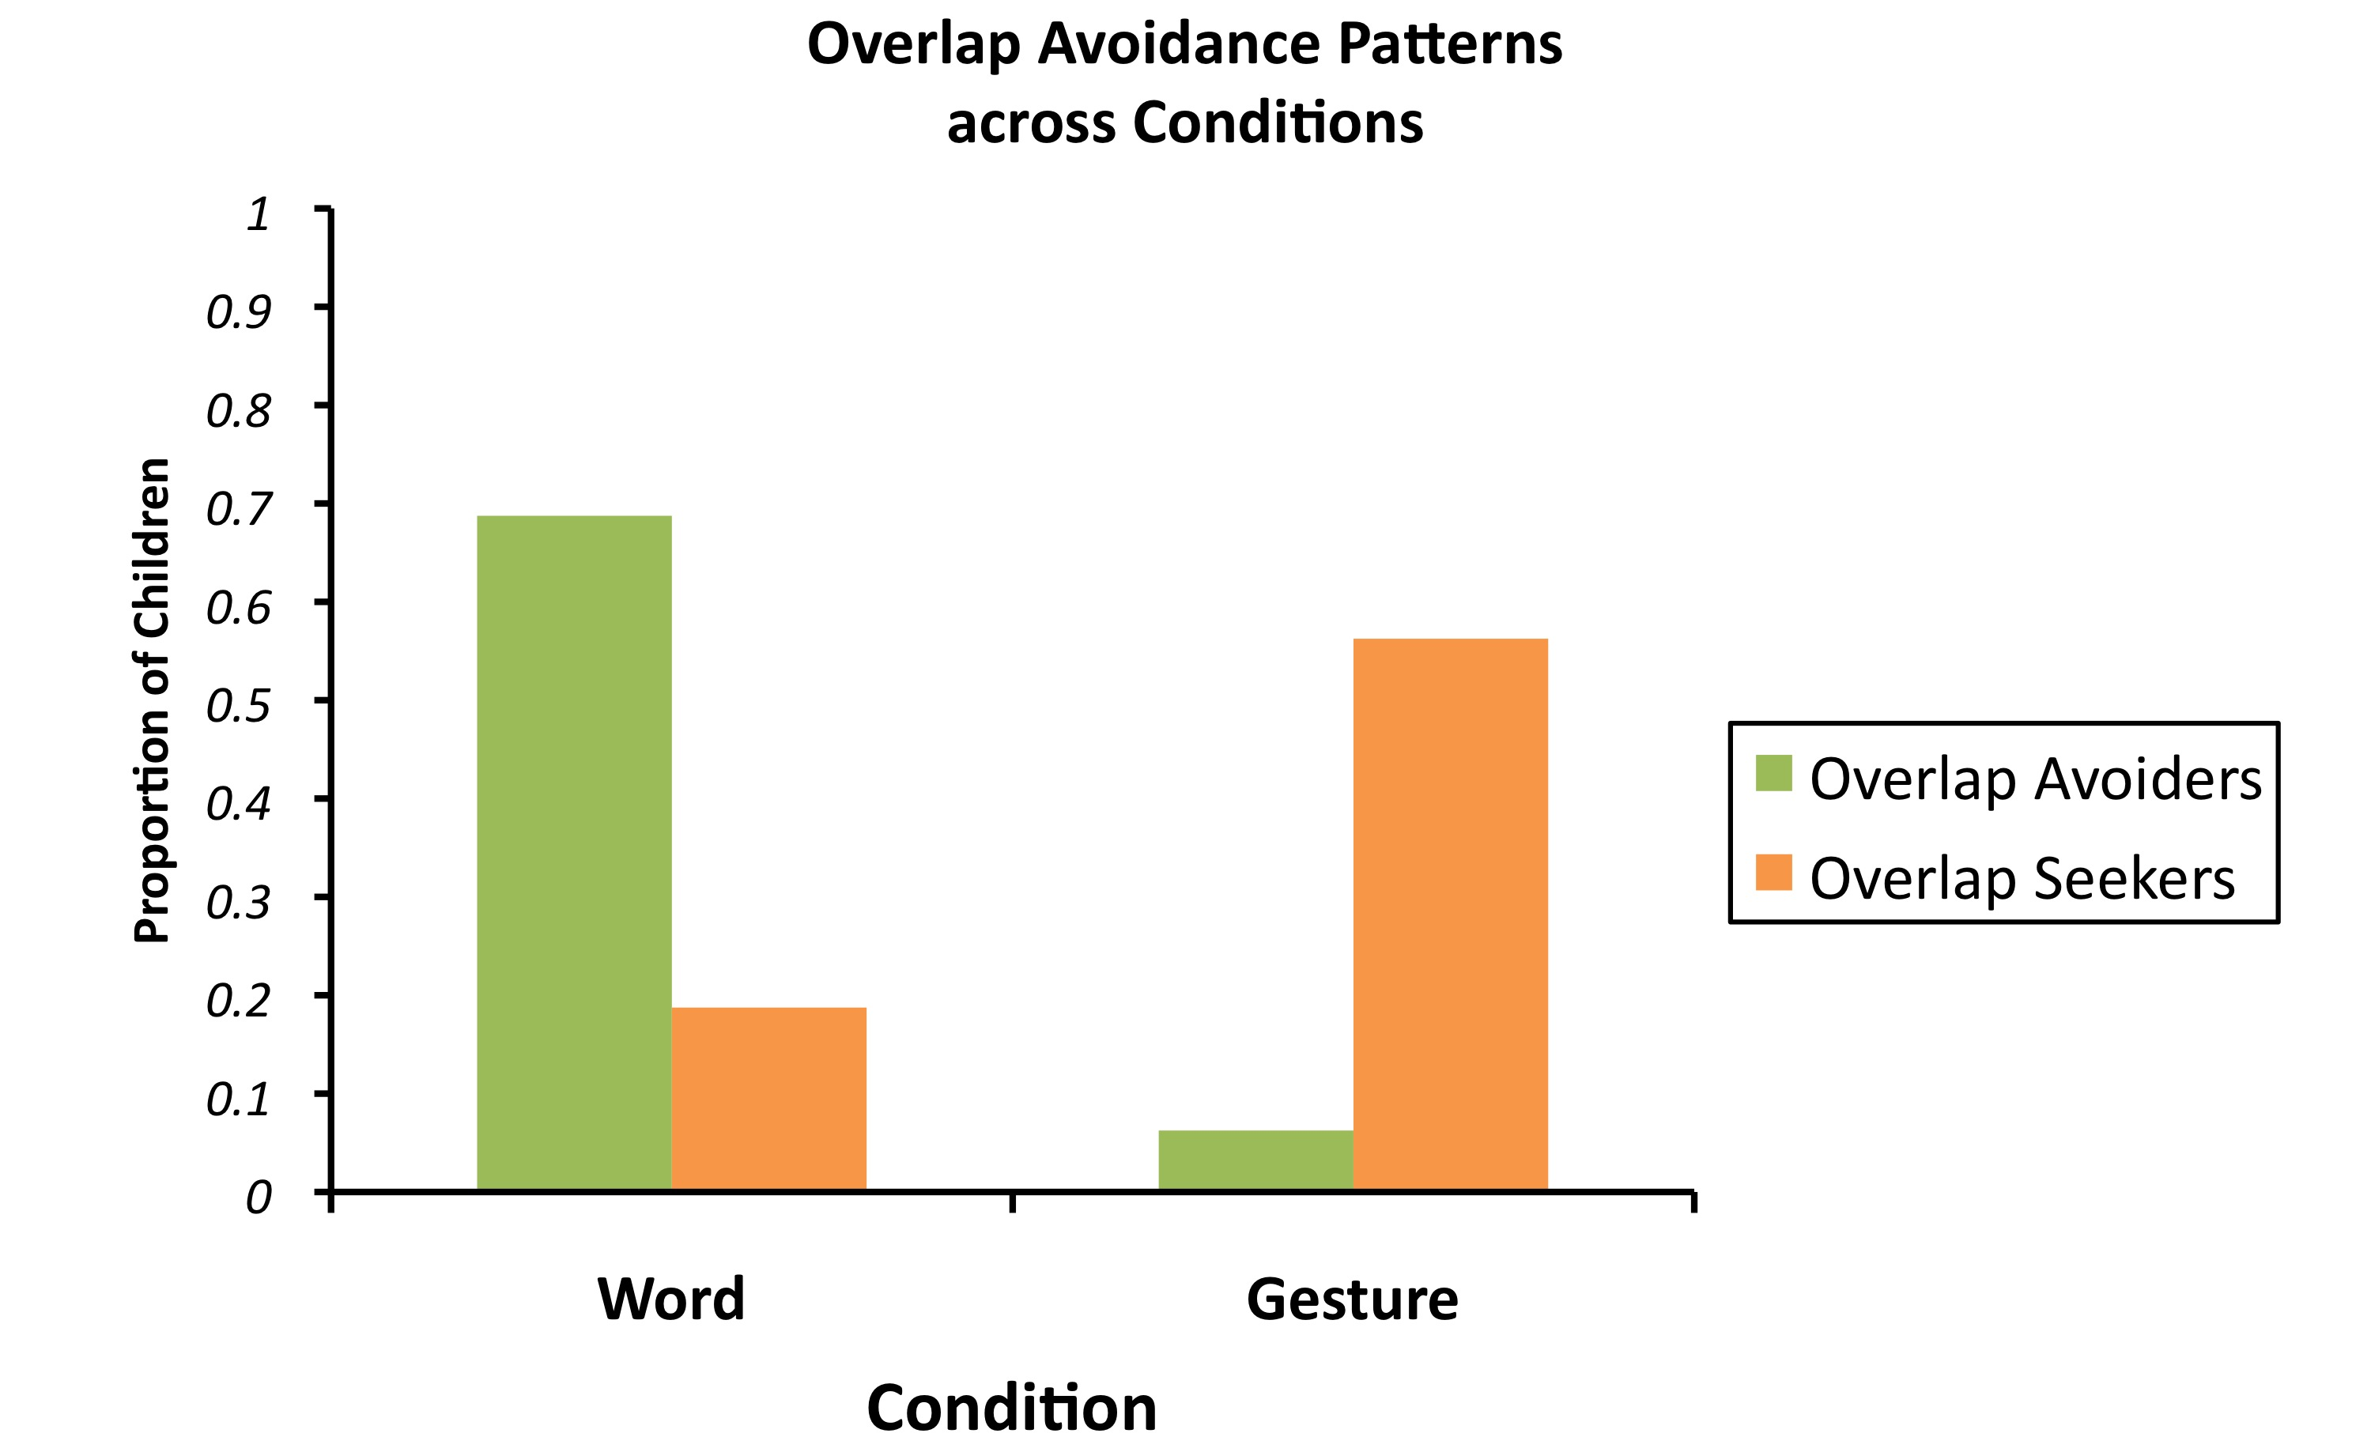
Results: Individual Patterns
Suanda & Namy (2013) Child Dev.

